Slide 1
Group A
Name | Matric Number
Lim Huey Wen | 23005873
Loh Jiang Joe | 23006181
Gan Ng Hee | 23005870
Tee Hui En | 23005825
Tan Yee Tern | 23006131

Slide 2
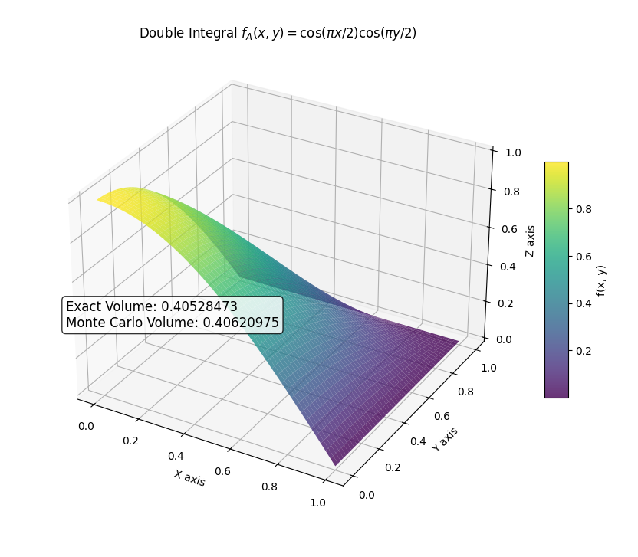
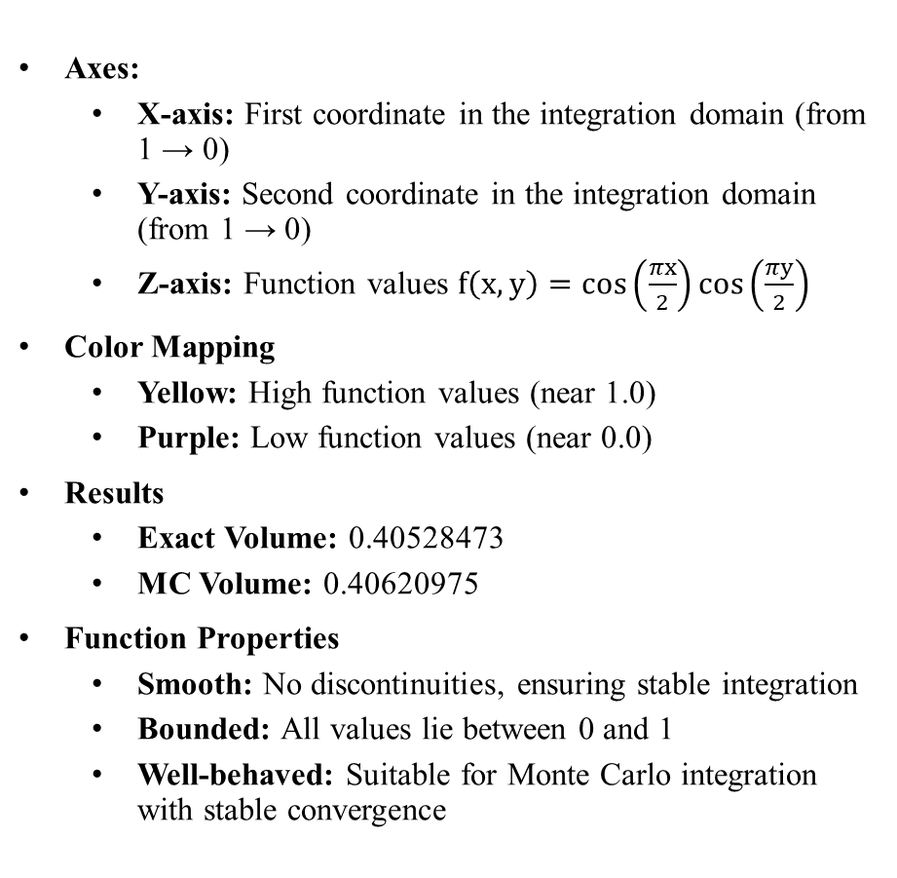
Part 1
Axes:
  X-axis: First coordinate in the integration domain (from 1 → 0)
  Y-axis: Second coordinate in the integration domain (from 1 → 0)
  Z-axis: Function values $f\left(x, y\right)=\cos\left(\frac{πx}{2}\right)\cos\left(\frac{πy}{2}\right)$
Color Mapping
  Yellow: High function values (near 1.0)
  Purple: Low function values (near 0.0)
Results
  Exact Volume: 0.40528473
  MC Volume: 0.40620975
Function Properties
  Smooth: No discontinuities, ensuring stable integration
  Bounded: All values lie between 0 and 1
  Well-behaved: Suitable for Monte Carlo integration with stable convergence

Slide 3
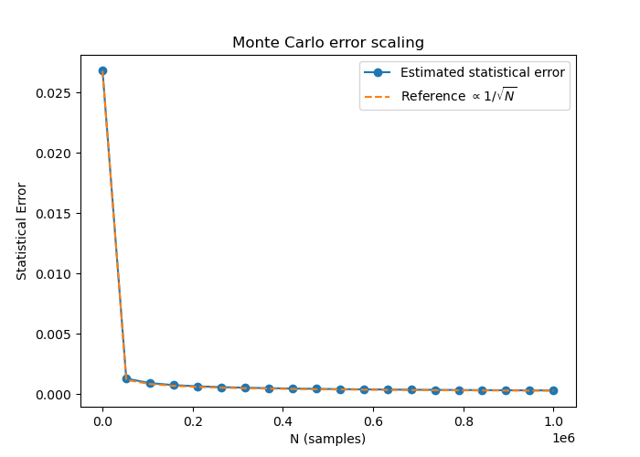
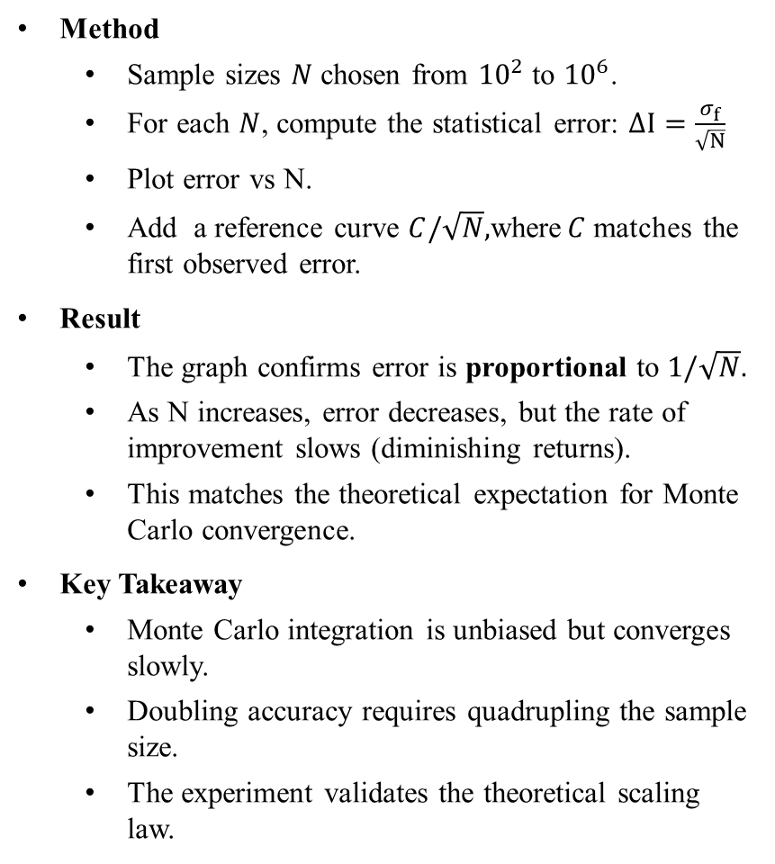
Part 2
Method
  Sample sizes $N$ chosen from ${10}^{2}$ to ${10}^{6}$.
  For each $N$, compute the statistical error: $∆I=\frac{σ_{f}}{\sqrt{N}}$
  Plot error vs N.
  Add a reference curve $C/\sqrt{N},$where$C$matches the first observed error.
Result
  The graph confirms error is proportional to $1/\sqrt{N}.$
  As N increases, error decreases, but the rate of improvement slows (diminishing returns).
  This matches the theoretical expectation for Monte Carlo convergence.
Key Takeaway
  Monte Carlo integration is unbiased but converges slowly.
  Doubling accuracy requires quadrupling the sample size.
  The experiment validates the theoretical scaling law.

Slide 4
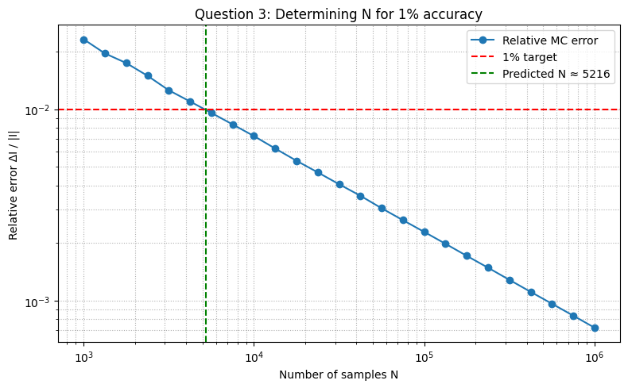
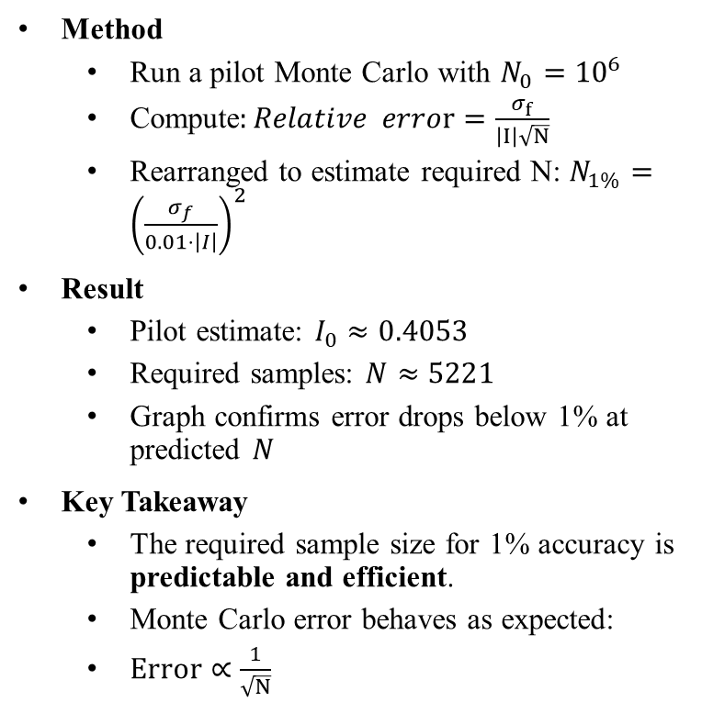
Part 3
Method
  Run a pilot Monte Carlo with $N_{0}={10}^{6}$
  Compute$:Relative error=\frac{σ_{f}}{\left|I\right|\sqrt{N}}$
  Rearranged to estimate required N: $N_{1\%}={\left(\frac{σ_{f}}{0.01⋅\left|I\right|}\right)}^{2}$
Result
  Pilot estimate: $I_{0}≈0.4053$
  Required samples: $N≈5221$
  Graph confirms error drops below 1% at predicted $N$
Key Takeaway
  The required sample size for 1% accuracy is predictable and efficient.
  Monte Carlo error behaves as expected:
  $Error∝\frac{1}{\sqrt{N}}$

Slide 5
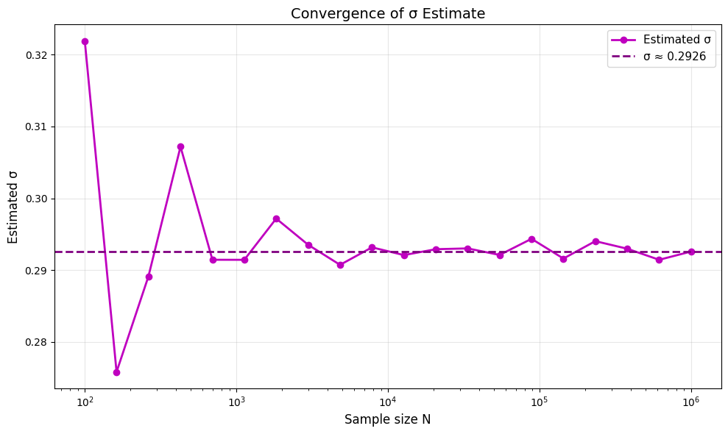
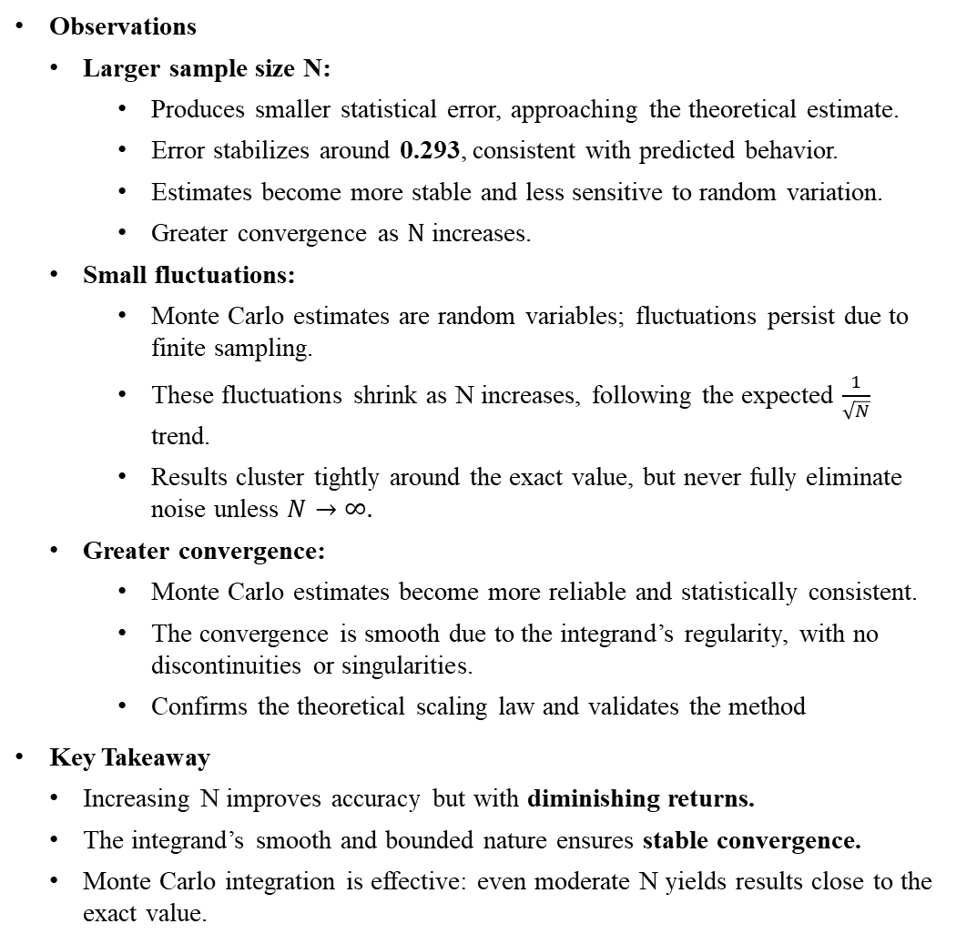
Part 4
Observations
  Larger sample size N:
    Produces smaller statistical error, approaching the theoretical estimate.
    Error stabilizes around 0.293, consistent with predicted behavior.
    Estimates become more stable and less sensitive to random variation.
    Greater convergence as $N$ increases.
  Small fluctuations:
    Monte Carlo estimates are random variables; fluctuations persist due to finite sampling.
    These fluctuations shrink as N increases, following the expected $\frac{1}{\sqrt{N}}$ trend.
    Results cluster tightly around the exact value, but never fully eliminate noise unless $N→∞.$
  Greater convergence:
    Monte Carlo estimates become more reliable and statistically consistent.
    The convergence is smooth due to the integrand’s regularity, with no discontinuities or singularities.
    Confirms the theoretical scaling law and validates the method
Key Takeaway
  Increasing N improves accuracy but with diminishing returns.
  The integrand’s smooth and bounded nature ensures stable convergence.
  Monte Carlo integration is effective: even moderate N yields results close to the exact value.

